Slide 1






Customer-Churn Analysis of A Multinational Bank.
Team Members:
Venkateswarlu Amireddy
Sowjanya Devupalli
Abinay Goud Karnam
Navaneeth Ragi
Sharmila Alikapati

Slide 2
Agenda:
Motivation
Data Preprocessing
Implementation
Independent and Dependent Variables
Observations from the Heatmap Correlation Diagram
The model preparation and Preprocessing Steps
Conclusion
Future Work
Reference

Slide 3
Motivation
The aim of the project is to increase market share and company growth, is focused on a global bank that is experiencing severe client attrition.
The major goal is to perform a descriptive study in which we examine every attribute that affects churn.
The objective is identification potential churners that the bank can proactively reach out to them with effective service.

Slide 4
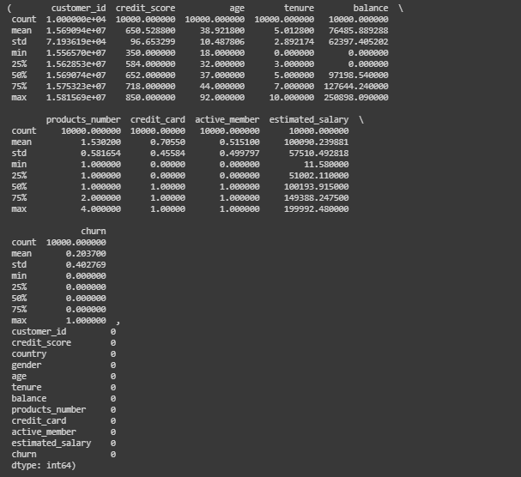
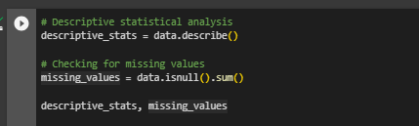
Data Preprocessing
Handling Missing values
Outliers
In this code we identify the null values for customer_id, credit_score, age, tenure, balance, products_number, credit_card, active_member, estimated_salary and churn.

Slide 5
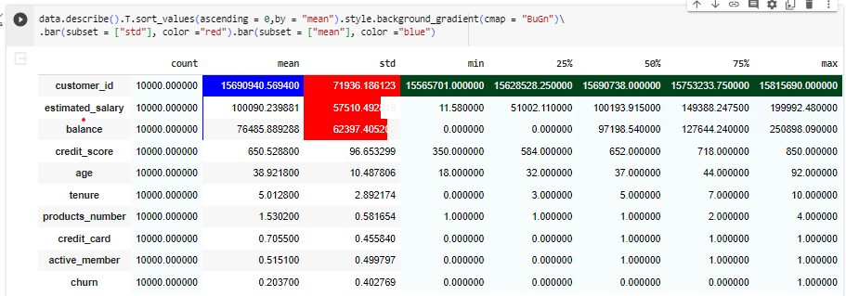
Exploratory Data Analysis

Slide 6
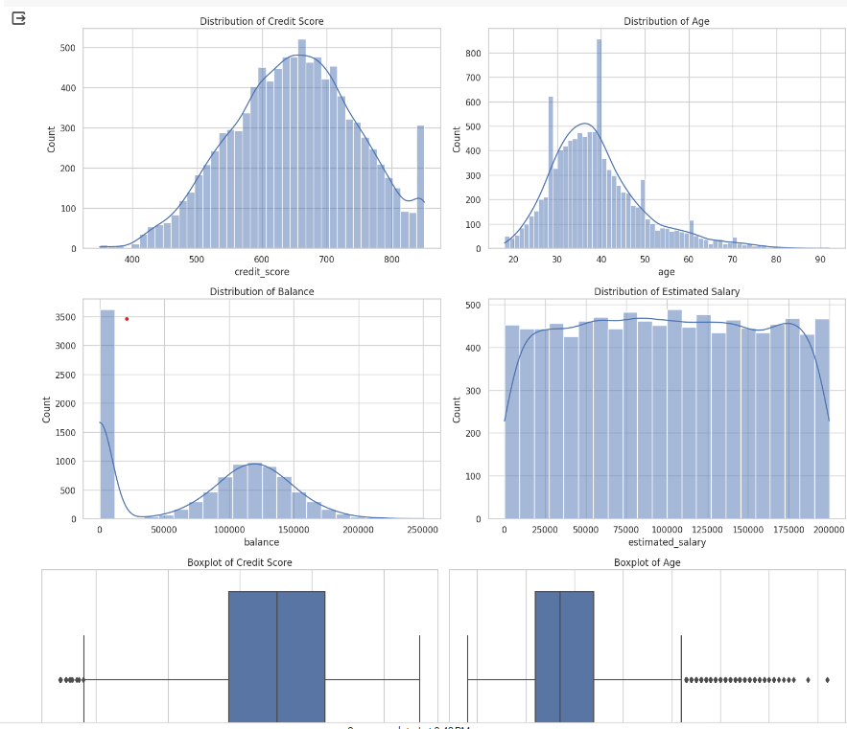
Univariate Analysis

Slide 7
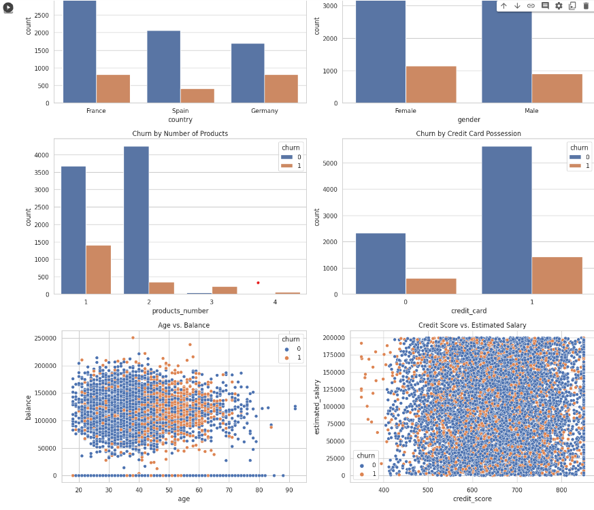
Bi-variate Analysis

Slide 8
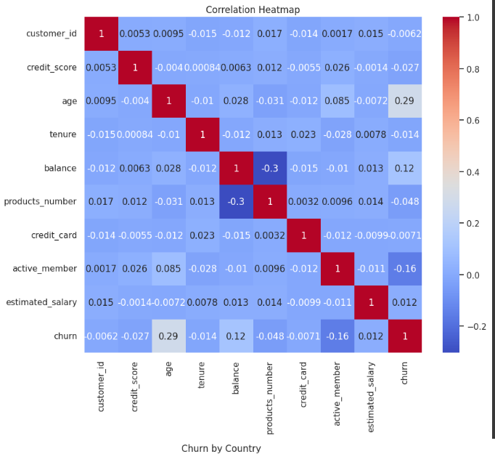
Multivariate Analysis

Slide 9
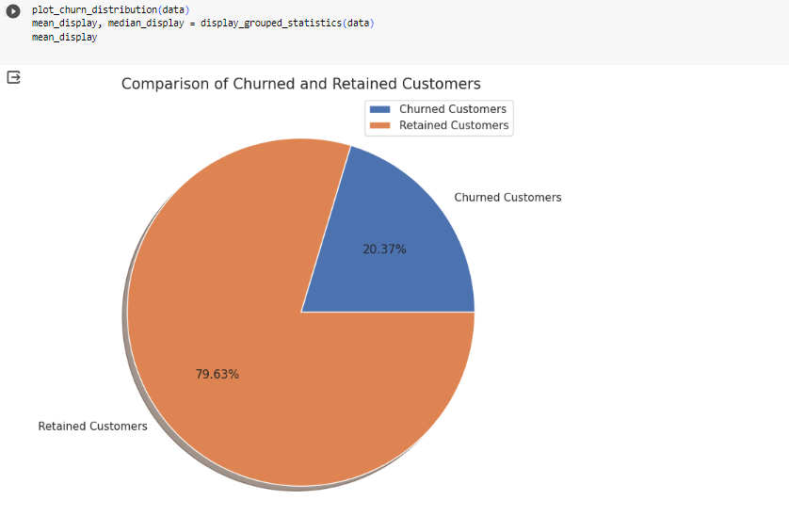
Comparison of Churned and Retained Customers

Slide 10
Implementation
The Logistic Regression classifier is used, trained on the data, and assessed for its ability to forecast customer attrition.
A financial dataset's customer turnover can be analyzed and predicted thanks to this methodical technique.

Slide 11
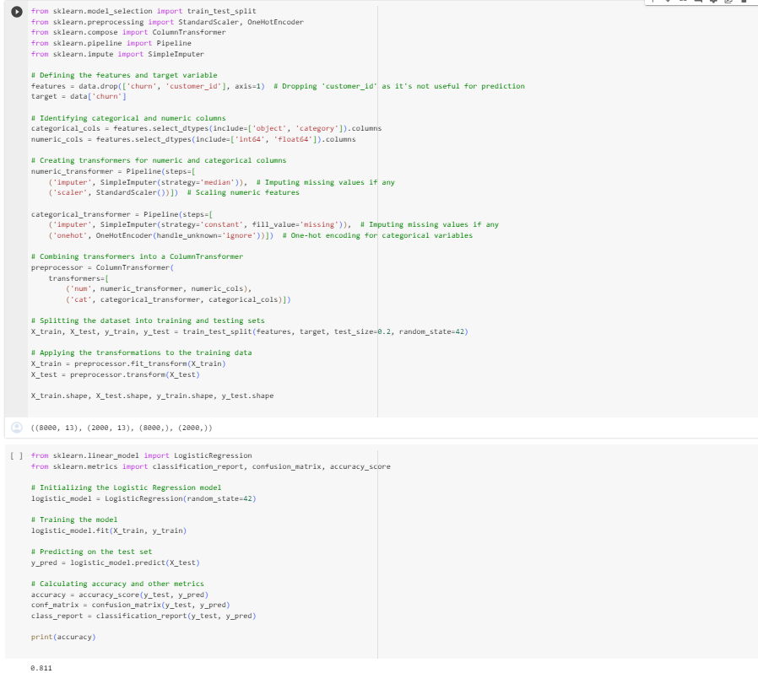

Slide 12
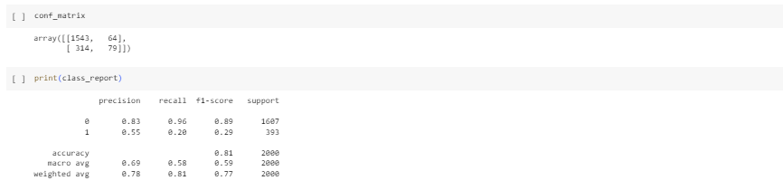

Slide 13
Conclusion
The preprocessed dataset, filling in missing values and encoding categorical variables for reliable model training.
The obtained insights into the elements impacting consumer behavior through exploratory data analysis.

Slide 14
Pending Work for final Draft:
Qualitative and Quantitative Analysis
Hypothesis testing
Final Documentation

Slide 15
References :
[1] Developing a prediction model for customer churn from electronic banking services using data mining https://jfinswufe.springeropen.com/articles/10.1186/s 40854-016-0029-6
[2] Customer churn prediction using composite deep learning technique https://www.nature.com/articles/s41598- 023-44396-w
[3] Reducing customer churn for banks and financial institutions. Article link

Slide 16
Thank You

